Slide 1
Enhanced Image Steganography using Dual Authentication and Camellia Cipher Encryption
Team Details
G. Mahalakshmi Sai Padmini (20EG105415)
B. Vaishnavi (20EG105406)
CH. Shreya (20EG105407)
Project Supervisor
Dr. K. Madhuri
Associate Professor

Slide 2
Introduction
The issue in the field of image data security and steganography applications is that there isn't a generally effective way to evaluate content similarity between different image datasets and embedding distortions within images. Because the current methods lack a clear methodology, it is difficult to assess the comparability of content among sets of photos. With an emphasis on PNG pictures specifically, a novel technique has been devised.
The project aims to implement a robust security framework encompassing a Dual Authentication Mechanism using the Diffie Hellman Algorithm, Algorithm Implementation for Cover Image Selection, Camellia Cipher Integration, and Comprehensive Image Steganography. This system ensures secure communication by authenticating parties, selecting appropriate cover images, encrypting data with Camellia Cipher, and concealing information within images. Practical applications include secure exchange of critical military plans, confidential transmission of patient records in healthcare, anonymous tips for journalists, and secure information exchange among government agencies.

Slide 3
Problem Statement
This project addresses a key challenge in steganography, which is the lack of a universally effective method for assessing content similarity across diverse image collections. Previous studies often lacked adaptability to diverse content types, resulting in suboptimal performance across different scenarios. Those studies included using KL Divergence for embedding distortion and Singular Value Decomposition for the Image Similarity which resulted to be flaw in the case of Changes in Image Contrast, Brightness and Flipping. So, this project introduces an adaptive algorithm designed to work with various content types, with a specific focus on PNG images and take the Text and Image Compression into consideration with special focus on Image Parameters like Fractal dimension, Edge detection, SSIM calculation, and entropy to comprehensively evaluate content similarity, embedding distortion, and cover image selection.
By reducing the similarity between images within a batch, the method ensures a diverse range of coverings, enhancing overall security.
Department of Computer Science and
4
Engineering

Slide 4
Proposed Method
Algorithm EnhancedSteganographywith_DualAuthentication_andCamelliaCipherAlgorithm (images, message)
Input: Set of Images, Message
# Stage 1: Image Selection and Preprocessing
selectedImage = ImageSelectionAndPreprocessing(images)
# Stage 2: Receiver Authentication
authenticatedReceiver = AuthenticateReceiver()
if authenticatedReceiver:
# Stage 3: Compression and Encryption
compressed_message = compress(Text)
encryptedMessage = EncryptMessage(message)

Slide 5
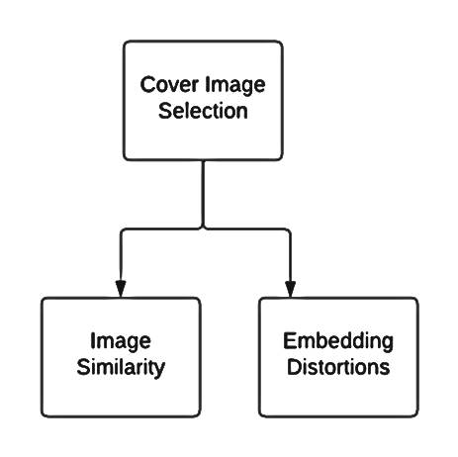
# Stage 4: Steganography
stegoImage = ApplySteganography(selectedImage, encryptedMessage)
# Stage 5: Data Transmission
TransmitStegoImage(stegoImage)
else:
DisplayAuthenticationFailureMessage()
End Algorithm

Slide 6
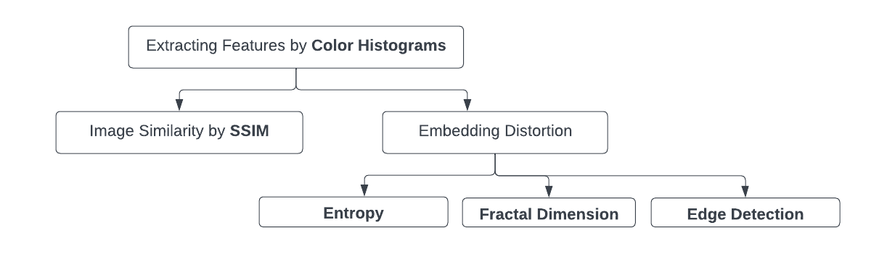
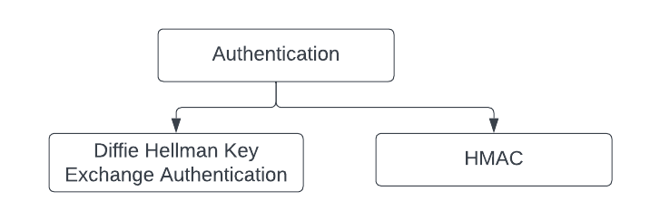


Slide 7
Experiment Environment
The environment used is PYTHON IDLE & COMMAND PROMPT
The packages used in our Python code is :
PILLOW PACKAGE: Used for image processing, to open, manipulate and save various image formats.
OS PACKAGE: To interact with the operating system.
CRYPTOGRAPHY PACKAGE: For all cryptographic related operations.
PYCRYPTODOME PACKAGE: Used in the code for SHA-256, RANDOM.
BASE-64 PACKAGE: Used for particularly in image steganography without causing issues when we use character encoding or special characters.
TERMCOLOR PACKAGE: Used to add the color text, various background colors to output console.
PYFIGLET PACKAGE: To create ASCII text and attractive headers using font and width
GETPASS MODULE: To read passwords and ensure the passwords and sensitive data is not exposed.
SYS PACKAGE: To work with Python runtime Environment
RANDOM PACKAGE: For the generation of IV
TIME MODULE: To calculate the encryption and decryption time
BINASCII MODULE: To work with binary and ASCII encoded data
NUMPY PACKAGE: To work with arrays or matrices
SCIKIT-IMAGE PACKAGE: For calculating image quality metrics, specifically PSNR (Peak Signal-to-Noise Ratio) and MSE (Mean Squared Error), Other Image Metrics.
OPENCV PACKAGE: For computer vision tasks and image processing.
MATPLOTLIB.PYTPLOT: To create plots and visualizations

Slide 8
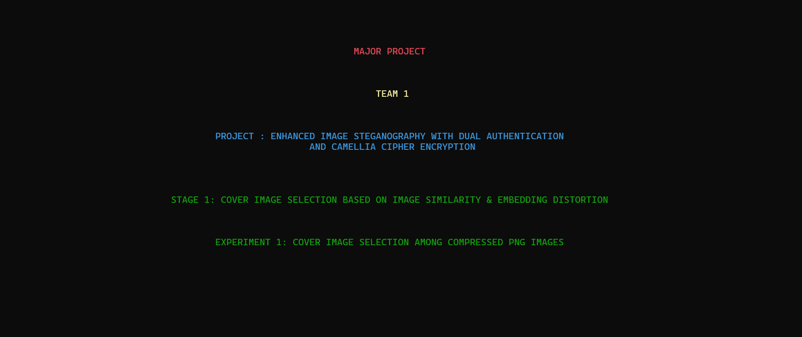
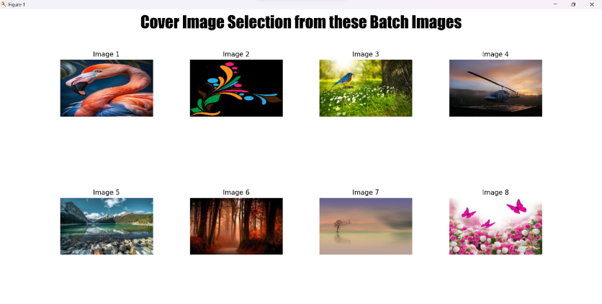
Experiment Screenshots
First we select a Cover Image from the 8 Compressed PNG Images based on Image Similarity and Embedding Distortion

Slide 9
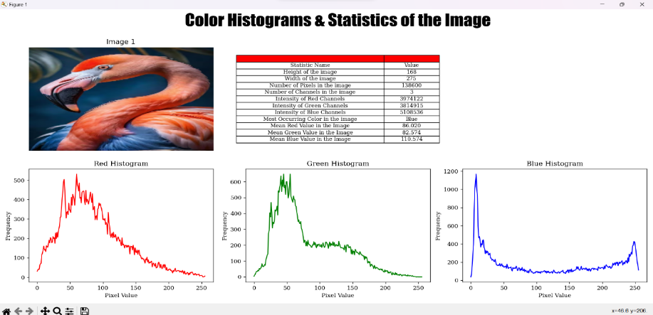
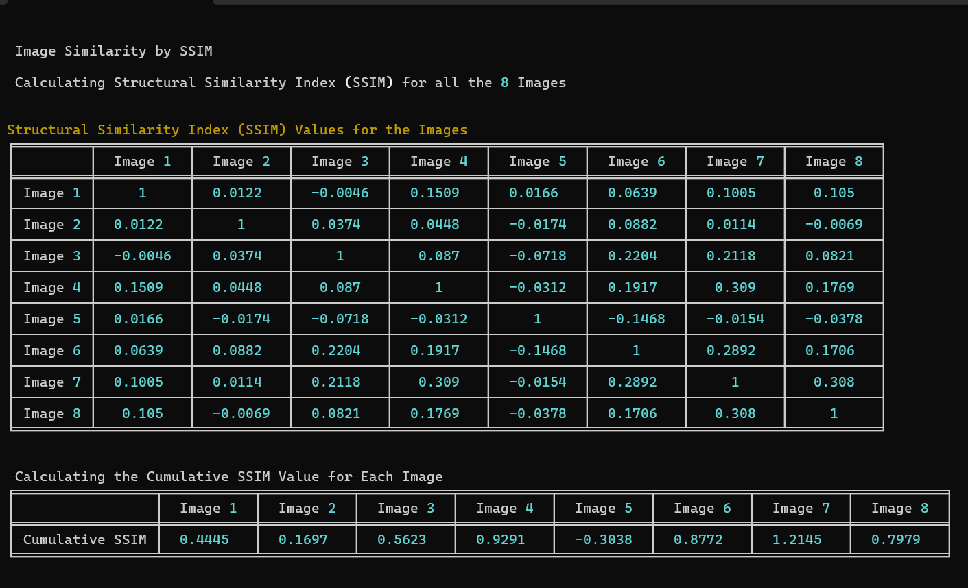
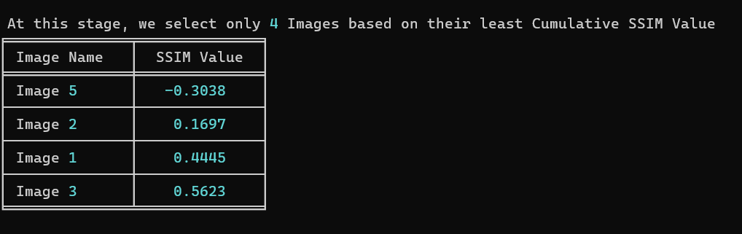
This includes Colour Histograms and Statistics of the Image along with SSIM Values and based on the least SSIM Value we select the 4 Images

Slide 10
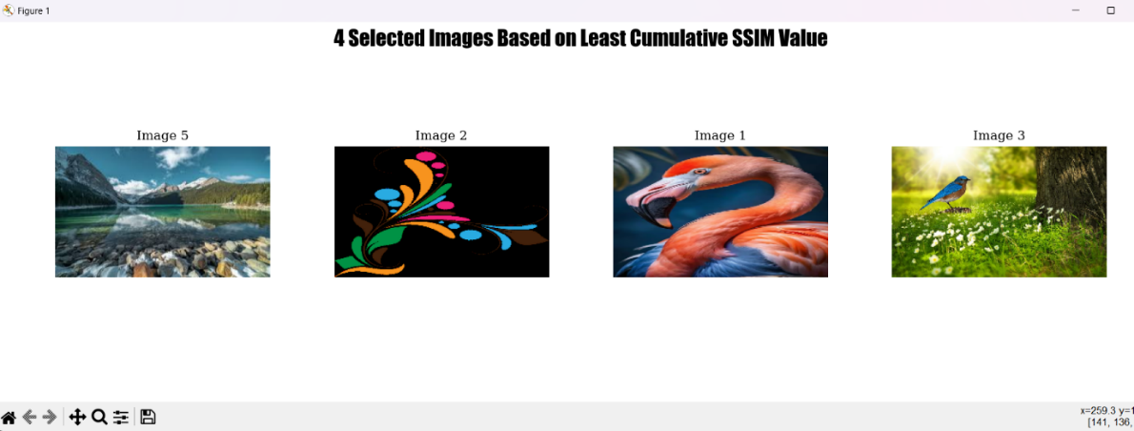
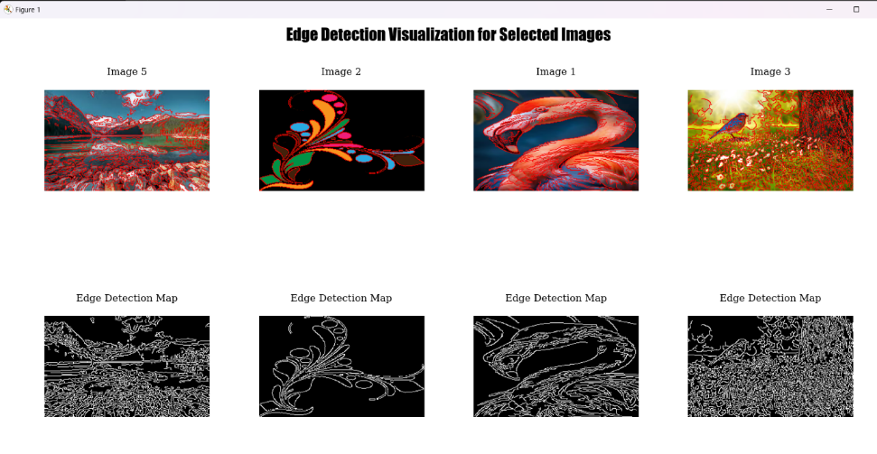
=
For those selected 4 Images then embedding Distortion is computed based on Edge Detection, Entropy and Fractal Dimension

Slide 11
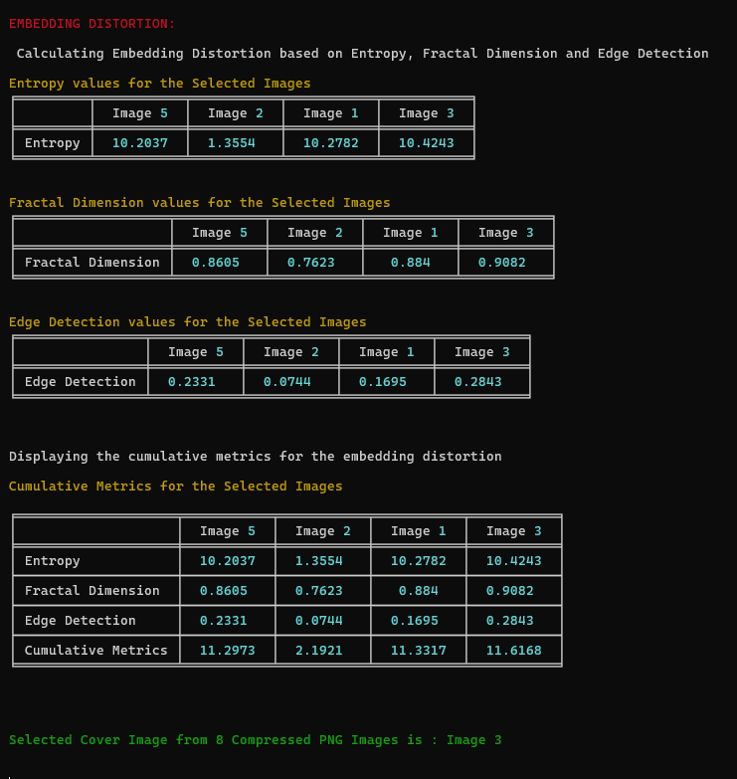
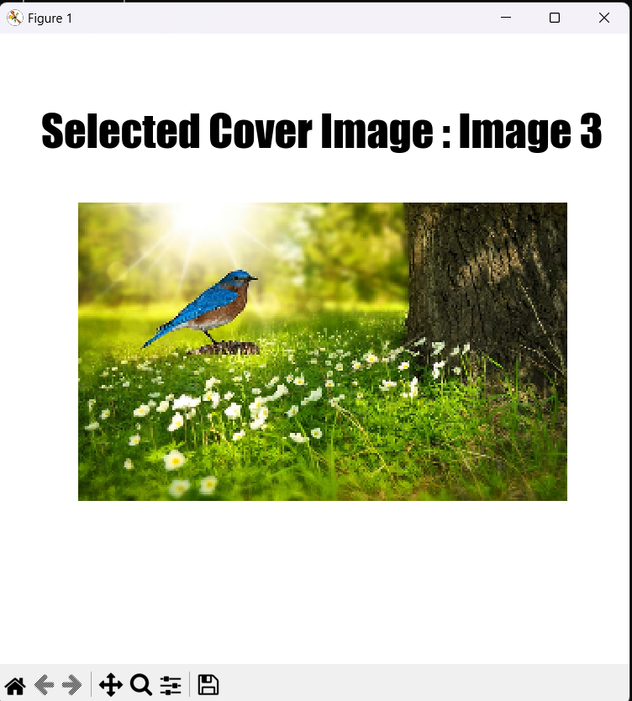
Based on the Highest Cumulative Metric Value, the Cover Image is selected.

Slide 12

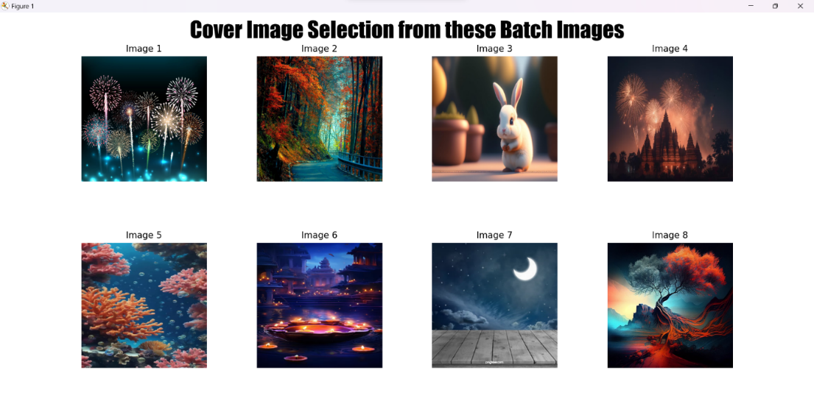
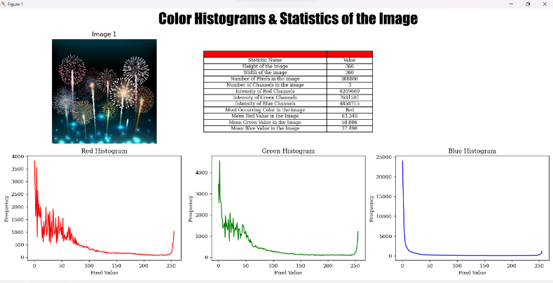
The same process is repeated for the other 8 Uncompressed PNG Images where at last 1 Final Image is selected

Slide 13
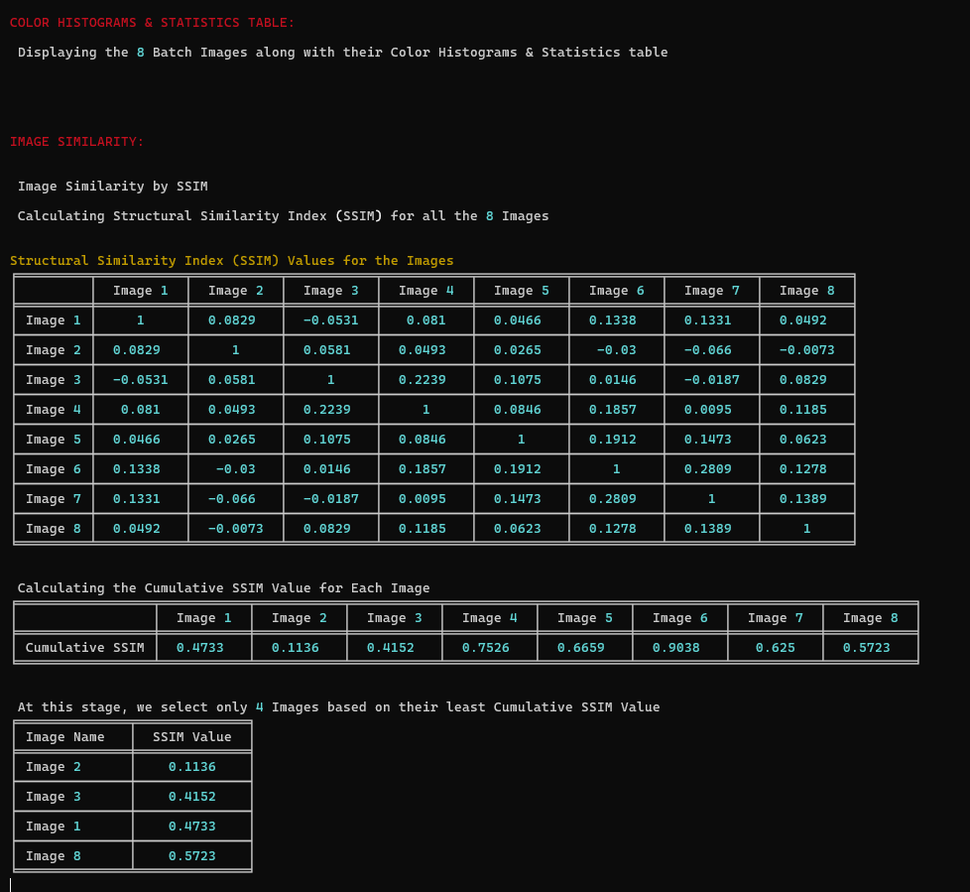
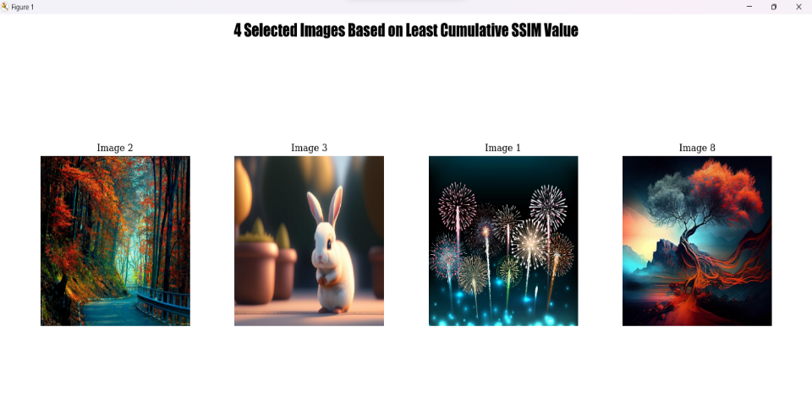
4 Images are selected based on the Least Cumulative Value and then Embedding Distortion of each image is calculated.

Slide 14
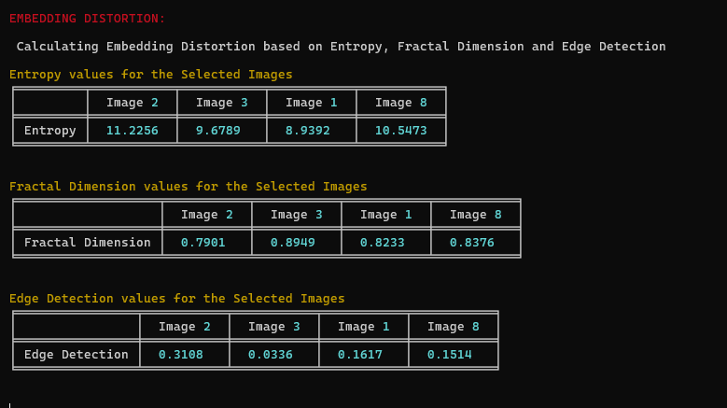
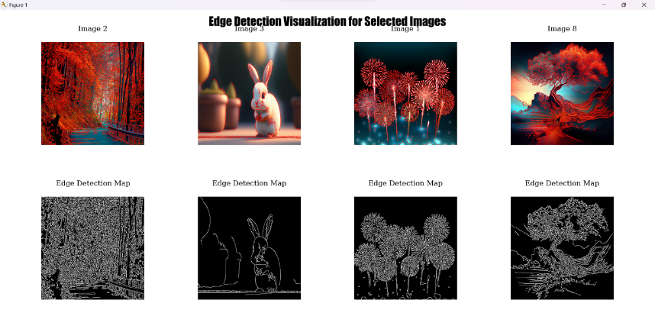
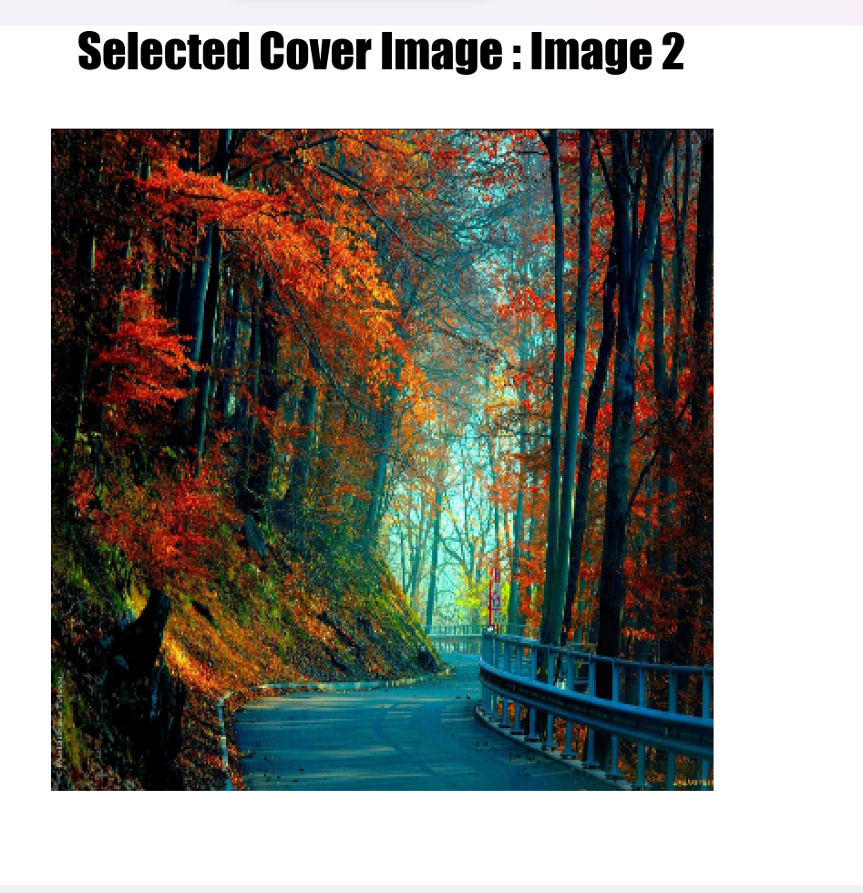
Finally Cover Image among the Uncompressed Images is selected

Slide 15
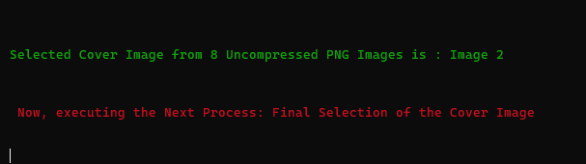
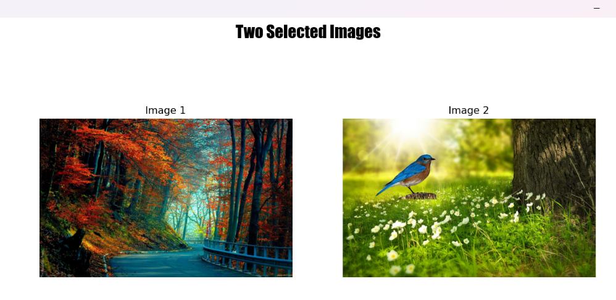

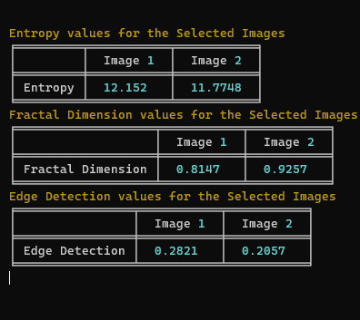
Now among those 2 Images, we again calculate the Embedding Distortion of the each image based on Entropy, Fractal Dimension and Edge Detection and then Select the Final Cover Image

Slide 16
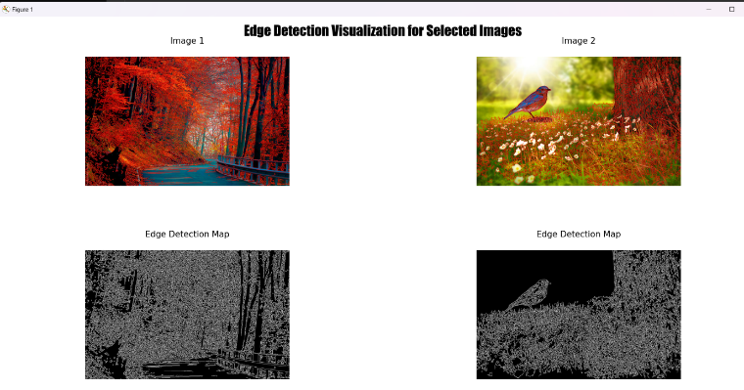
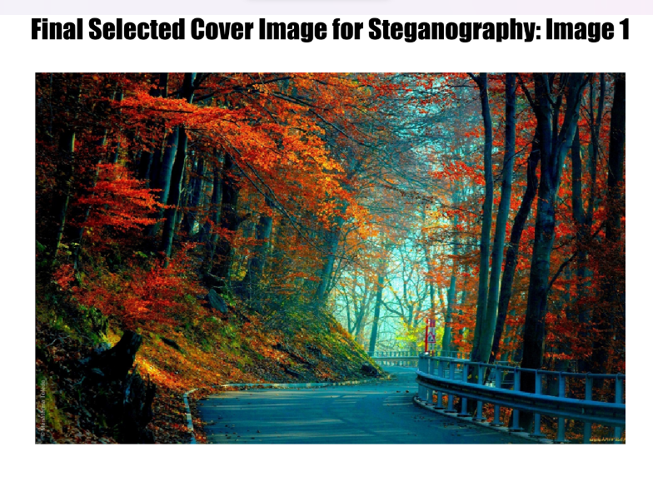
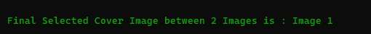
Atlast, the Final Cover Image for the Steganography process is selected and then we proceed to the next stage

Slide 17
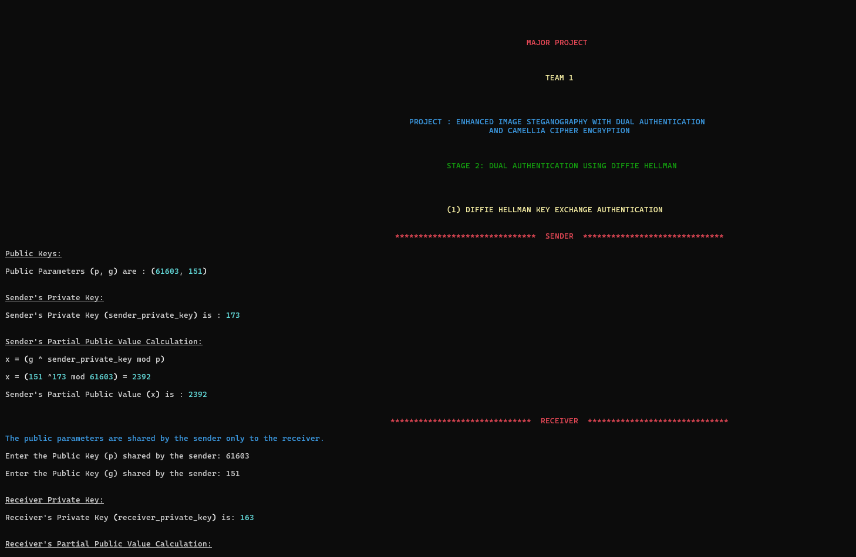
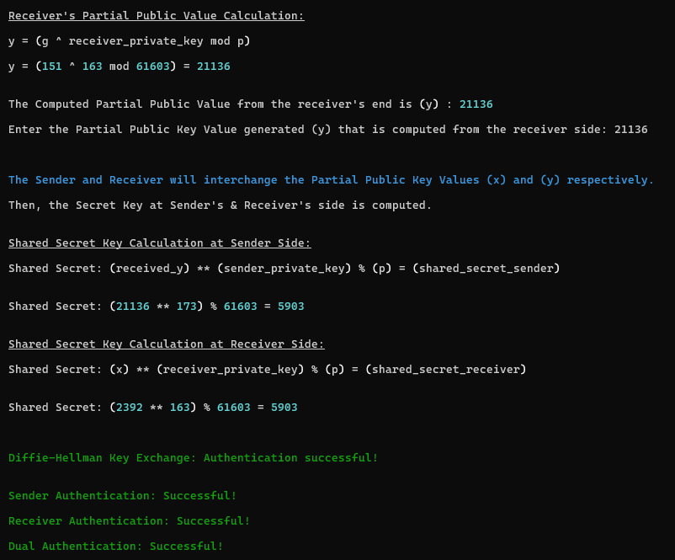
The next will be the Dual Authentication (Sender and Receiver) which will be done using the Diffie Hellman Key Exchange Algorithm

Slide 18
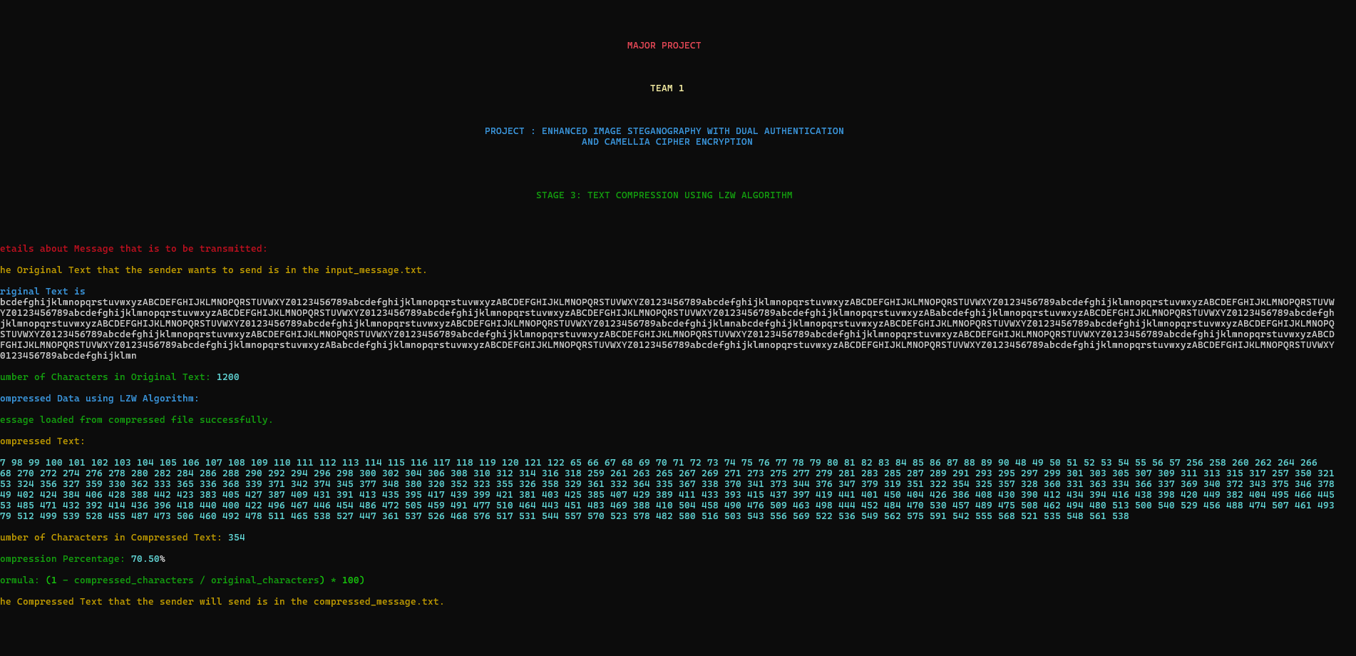
Not only Image Compression our project also dealt with Text Compression using the LZW Algorithm where the text size is almost compressed more than 50%

Slide 19
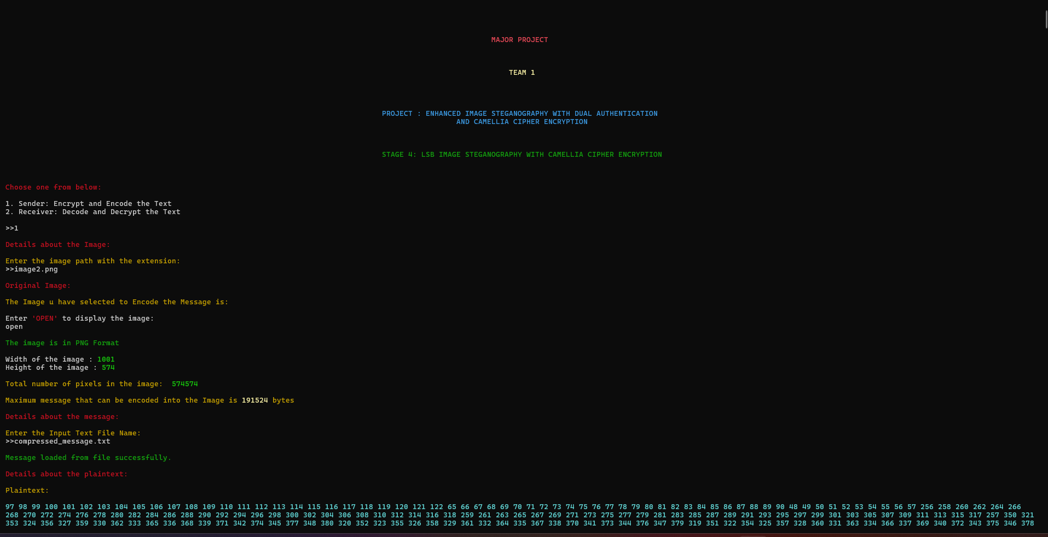
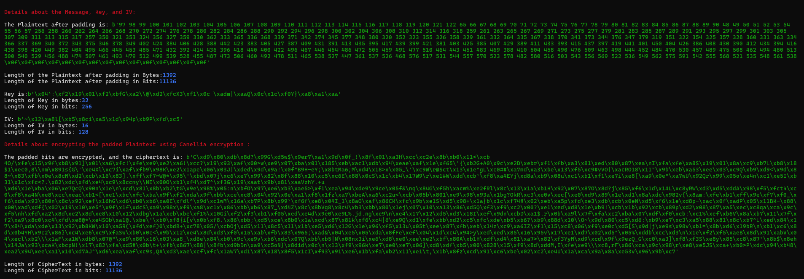
Next we have the actual Steganography Process which involves the Encrypting the Compressed Text using Camelia Cipher, using Base-64 Encoding and then Encoding the text into the selected Cover Image

Slide 20
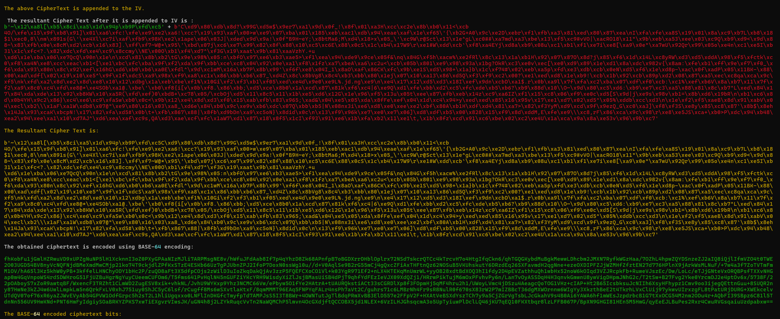
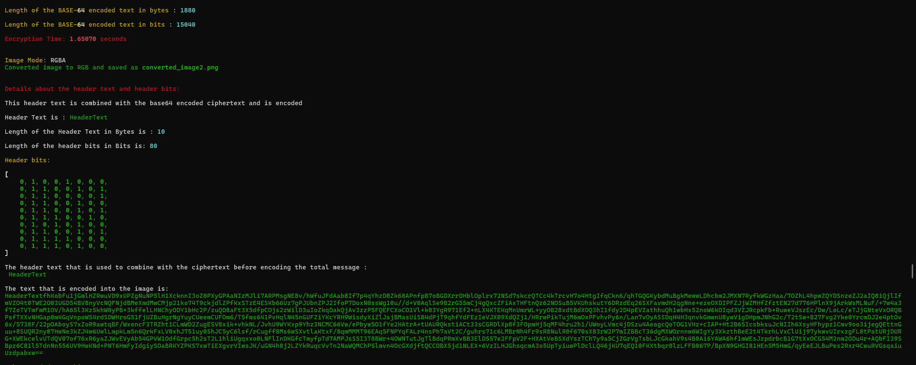
This also involved adding IV to the Ciphertext and then doing encoding using Base-64 and then adding Header Text and then encoding into the Image
Clear representations of each and every stage is displayed and also explained.

Slide 21
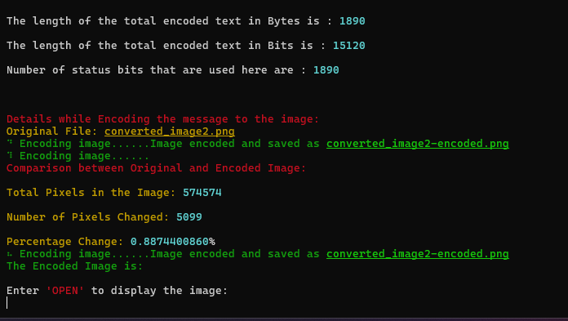
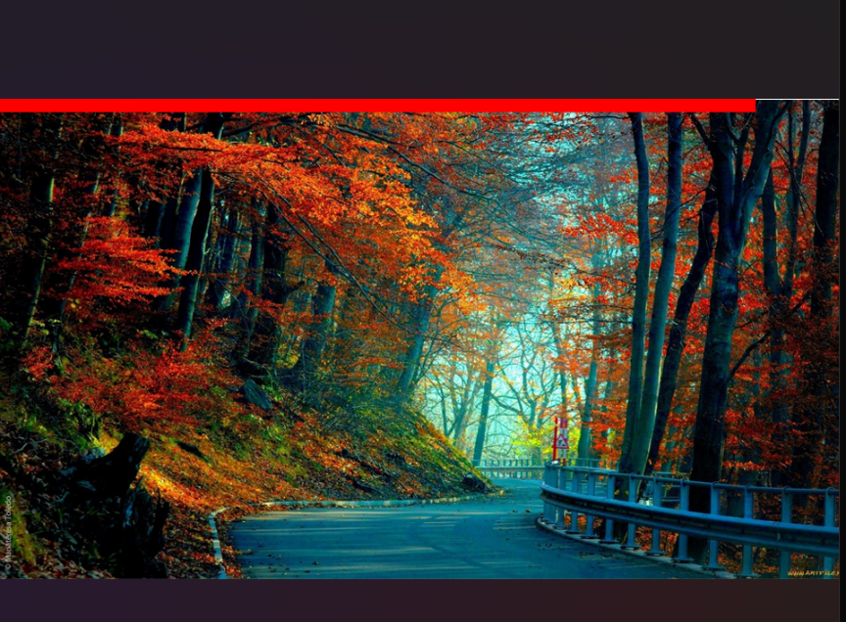
Then the text at what place it is encoded in the image is also displayed using the bold red line for the viewers to understand that encryption is done

Slide 22
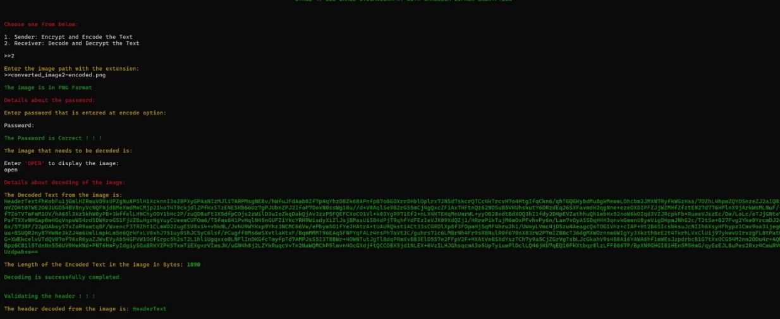
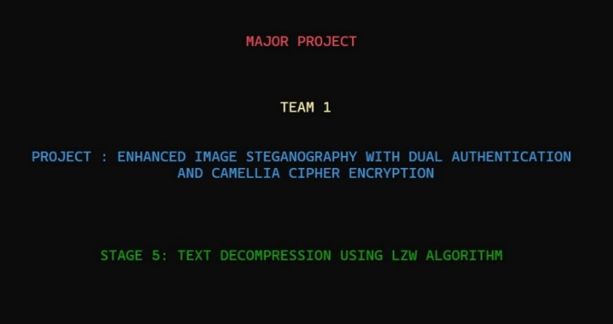
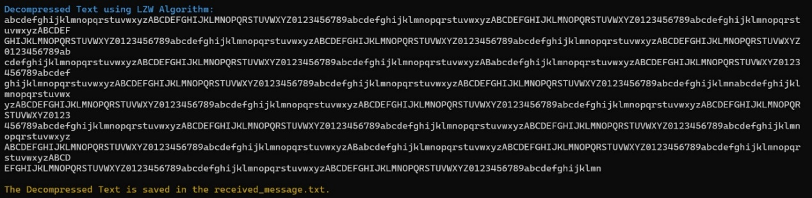
And at the last decoding and decryption is also done and then followed by the Text Decompression and is displayed in the form of .txt file

Slide 23
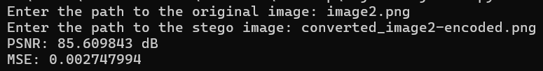
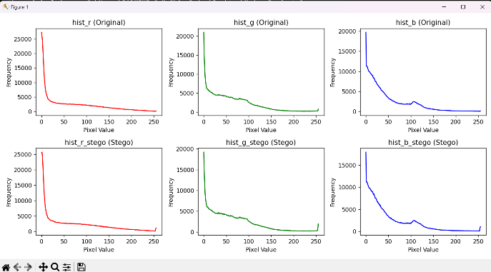
Experiment Results
Separate Python file has written to measure the Experiment results based on PSNR & MSE Values along with the representation of the Colour Histograms between the Original and Stego Image to understand that Stego image is not detected easily.

Slide 24
Finding
We found that “Enhanced Image Steganography using Dual Authentication and Camellia Cipher Encryption ” is secure against Chosen-Plaintext attack, Differential Cryptanalysis, Known- Plaintext attacks.
Through these Camellia Cipher Encryption and Decryption functions we are able to achieve Privacy.
We can use other modes of image to convert into RGB such as CMYK, GREYSCALE, RGBA.
We have observed that Uncompressed PNG Images are better choice for the Final Cover Image Selection compared to the Compressed PNG Images
Dual authentication using Diffie-Hellman involves a cryptographic protocol where both communicating parties authenticate each other
Using LZW text compression for the text that needs to be encoded in image steganography offers the advantage of reducing the size of the text payload, allowing for more efficient embedding within the image without significantly affecting the image's visual quality.

Slide 25
Justification
Parameters | Formula | Previous value | Result value | Justification
RGB Mode of the Image |  | We are only using RGB mode of the images in Image Steganography. | In this project, we are also able to use GREYSCALE, CMYK,RGBA Modes of Images also | We are using a function which converts the other forms of Image to RGB Mode of the Image
Camellia Cipher-256 | Using 256 bit Key | Using only AES-256 or DES | Usage of Camellia Cipher | Camellia has efficiency in certain software implementations and flexibility in supporting multiple key sizes offer advantages in performance and adaptability and also provide enhanced resistance to side-channel attacks compared to AES, contributing to its perceived strength in certain security contexts.

Slide 26
BASE-64 Encoding | Mapping 6 bits to the corresponding BASE 64 characters |  | The result is in right format. | Does not promote Security but it is the right format to use while encoding when the errors arise during Special Characters or the Encoded Characters
Diffie Hellman Key Exchange | Key Exchange Algorithm | Not used | The establishment of a shared secret key between two parties over an insecure communication channel, without the need for prior shared secrets. | It is used in sender and receiver authentication because it allows both parties to verify each other's identity and ensures that the communication is secure from eavesdropping and tampering, thus providing mutual authentication and confidentiality.

Slide 27
LZW Compression | The LZW (Lempel-Ziv-Welch) compression algorithm works by replacing repeated occurrences of data with references to a dictionary, thus reducing the overall size of the data. | Not used | LZW compression is a compressed version of the original data, which typically takes up less space. | Allows more text data to be encoded into the image without significantly increasing its size, thereby enhancing the capacity and stealthiness of the steganographic process.
PSNR (Peak Signal to Noise Ratio) | 10 * log10((peak^2) / MSE) | Used | PSNR values above 30 dB are generally considered high and indicative of good image quality. | The reconstructed image closely matches the original, resulting in high similarity between corresponding pixels. This leads to high PSNR Value.
MSE (Mean Squared Error) | (1 / (m * n)) * Σ(Σ(I(x, y) - K(x, y))^2) | Used | MSE measures the average squared difference between the pixel values of the original image and encoded image. | The reconstructed image closely matches the original, resulting in high similarity between corresponding pixels. This leads to a low MSE because there is minimal difference between pixels

Slide 28
THANK YOU

